Slide 1
Applied Natural Language Processing
Dr. Sucharitha Shetty

Slide 2
Table of Contents
Word2Vec

Slide 3
Vector Defn
Vector- A quantity having direction as well as magnitude, especially as determining the position of one point in space relative to another.
Now if something has magnitude and direction we can possibly do math with it and if we could do math with a vectorized form of a word then it creates possibilities of comparing one word to another in an N-dimensional space.

Slide 4
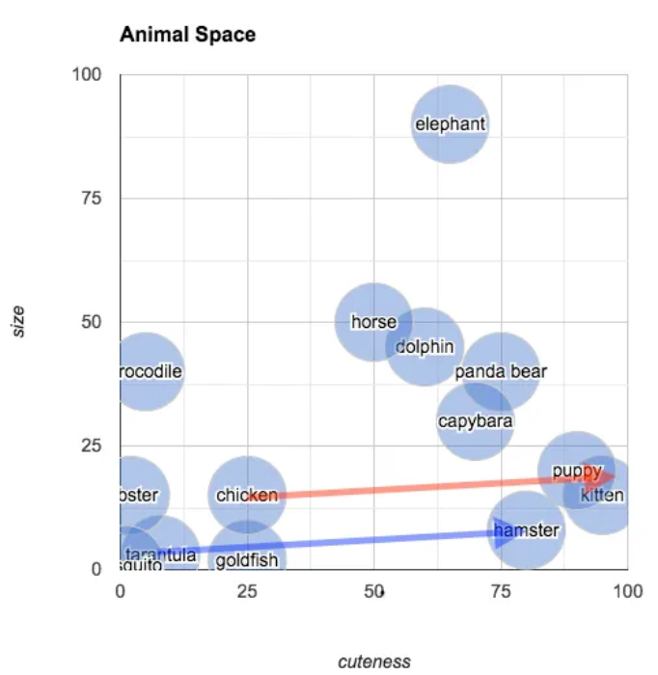
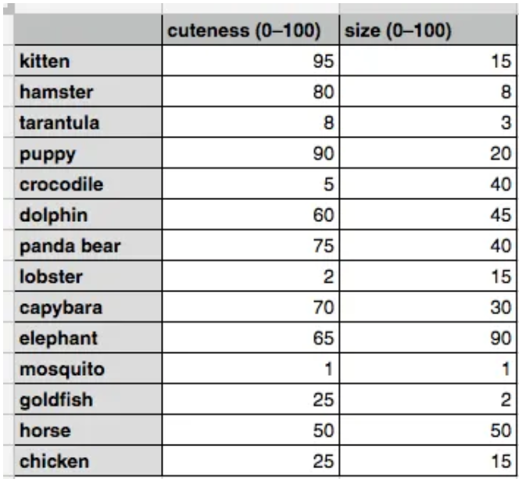
Example: Animal similarity and simple linear algebra

Slide 5
Animal similarity and simple linear algebra
The plot shows us that the closest animal to the capybara is the panda bear (again, in terms of its subjective size and cuteness). One way of calculating how “far apart” two points are is to find their Euclidean distance.
You can understand this arrow as being the relationship between a tarantula and a hamster, in terms of their size and cuteness. In the same diagram, I’ve also transposed this same arrow (this time in red) so that its origin point is “chicken.” The arrow ends closest to “kitten.” What we’ve discovered is that the animal that is about the same size as a chicken but much cuter is… a kitten. To put it in terms of an analogy:

Slide 6
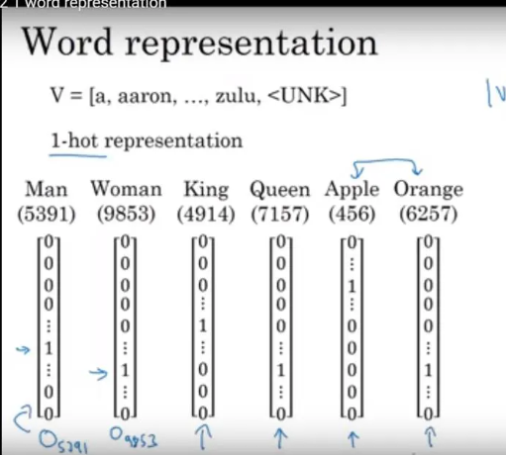
How are these words represented in an N-dimensional matrix?
Step 1- We one-hot encode each word. Here suppose the vocabulary is 10K words and each word is represented in with one-hot encoding with dimension as (1*10k)
Example — Man(5391) when represented in one hot encoding has only 1 at a single place as rest are all other words. It is also represented as O5391.

Slide 7
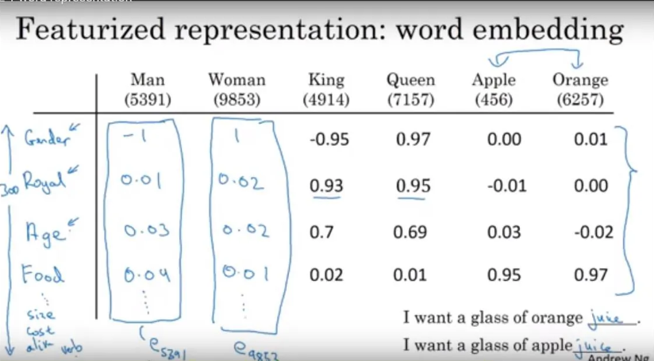

Slide 8
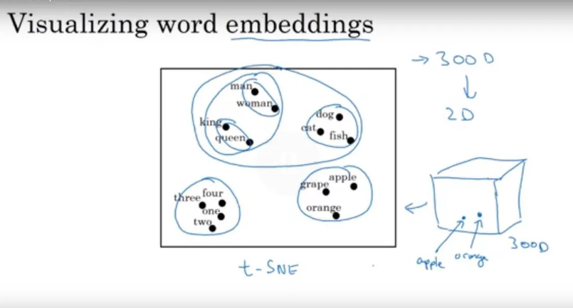
Visualizing Word Embedding in 2D : This can be done using TSNE which is used for dimensionality reduction.

Slide 9
How are these words represented in an N-dimensional matrix?
Step 2- When we have to find a N-dimensional vector corresponding to word we multiply the embedded matrix to the one-hot encoded form of a word and the output we get is an N-dimensional vector of that word.
Here to find a 300 dimensional vector corresponding to a word we multiply this embedded matrix to the one hot representation of that word which is 10k*1 and as the 1-hot representation will have only “1” present only once as 10k was a combination of unique words, so when multiplied with this embedded matrix we will have a (300*1) matrix which will have the values of all 300 dimension (how distant a word is from other dimensions). So, whenever we need such representation of a word we use such methodology.

Slide 10
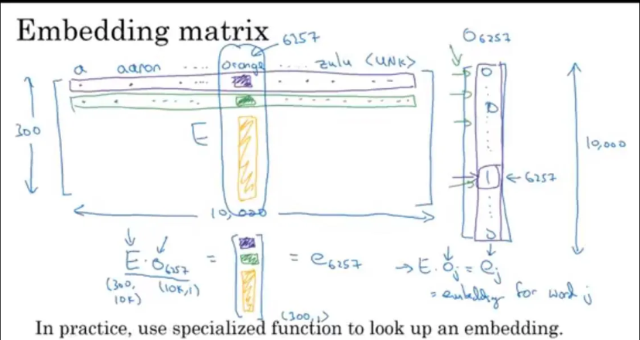
E.Oj=ej
(E=embedded matrix,
O=1-hot representation)

Slide 11
Word2Vec
CBOW (Continuous Bag Of Words) and Skip-Gram are two most popular frames for word embedding
In CBOW the words occurring in context (surrounding words) of a selected word are used as inputs and middle or selected word as the target. Its the other way round in Skip-Gram, here the middle word tries to predict the words coming before and after it.

Slide 12
CBOW (Continuous Bag Of Words)
Consider a text consisting of characters from ‘a’ to ‘z’ sequentially [a, b,c, d, e, f, g, h, i, j, k,l, m, n, o, p, q, r,s, t, u, v, w, x, y, z], further let integers 0 to 25 represent the respective letters. Implementing CBOW keeping the window size of 2, we can see that ‘a’ is related to ‘b’ and ‘c’, ‘b’ to ‘a’, ‘c’ and’ ‘d’ and so forth. It follows that one hot vector representing input words will be of dimension [26, 1]. With the help of the model, we will find the dense and distributed vector of size [10, 1]. The size of the embedding vector is selected arbitrarily.

Slide 13
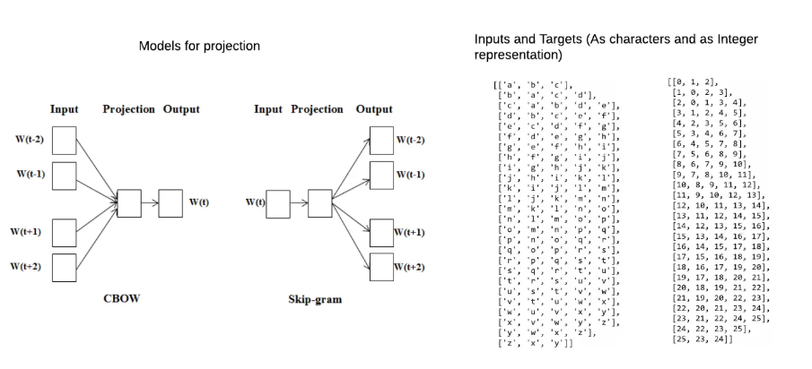
CBOW (Continuous Bag Of Words)

Slide 14
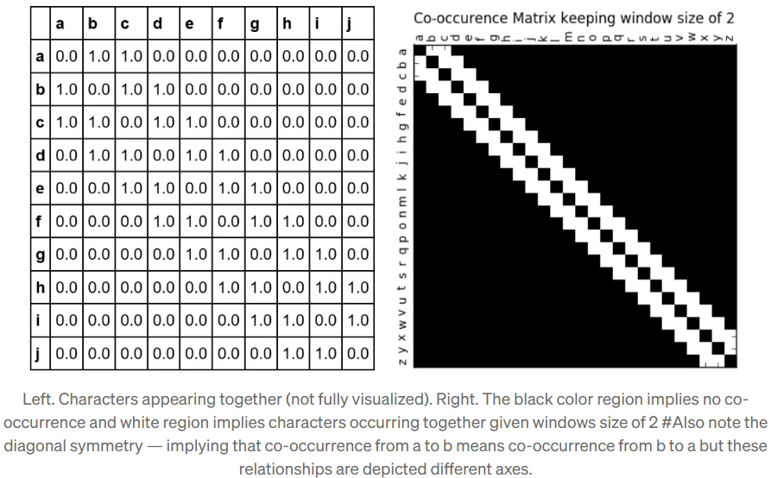
CBOW (Continuous Bag Of Words)

Slide 15
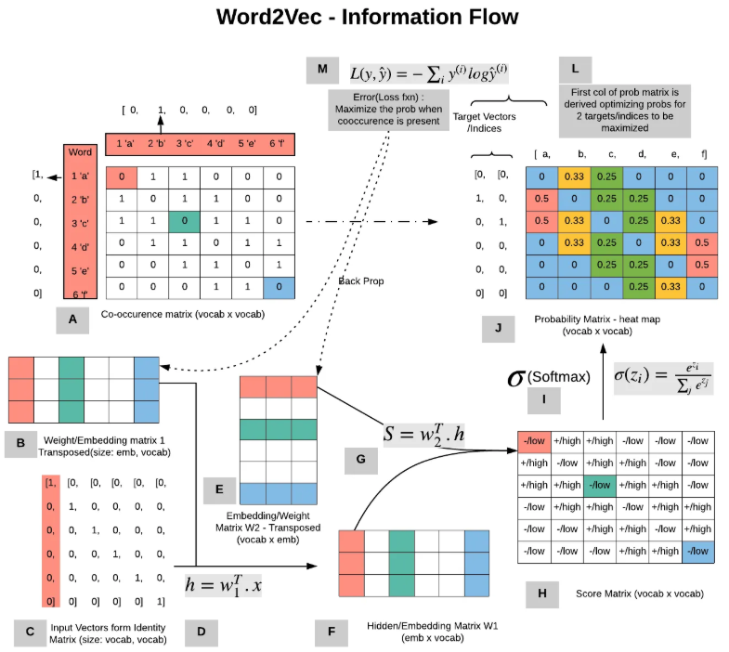

Slide 16
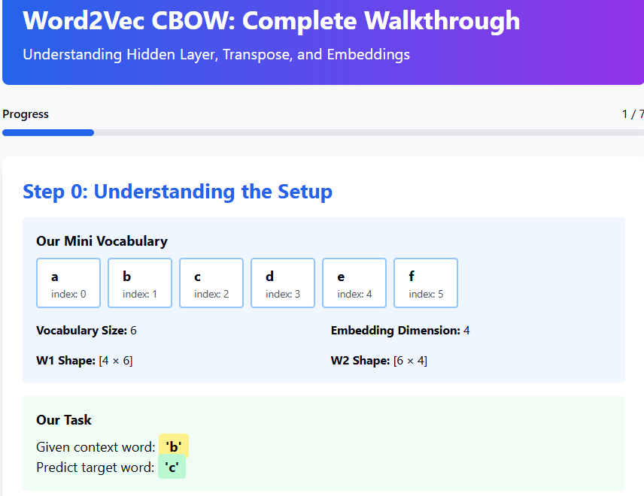

Slide 17
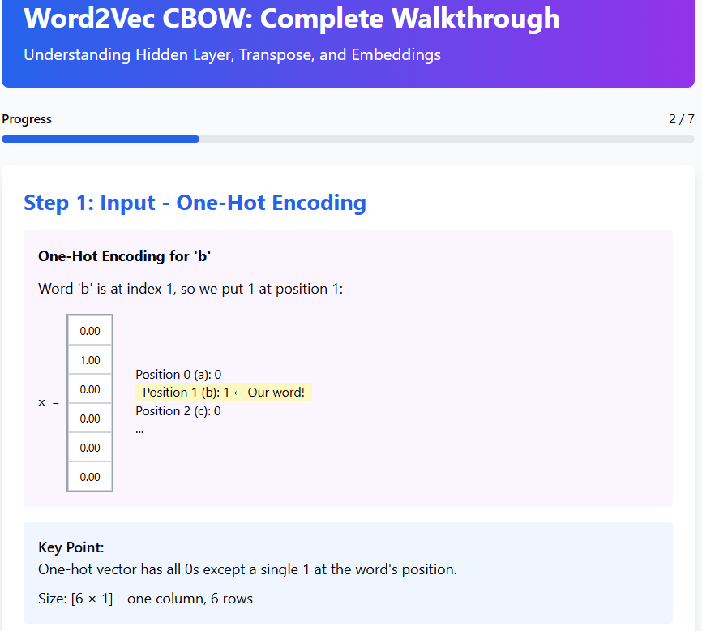

Slide 18
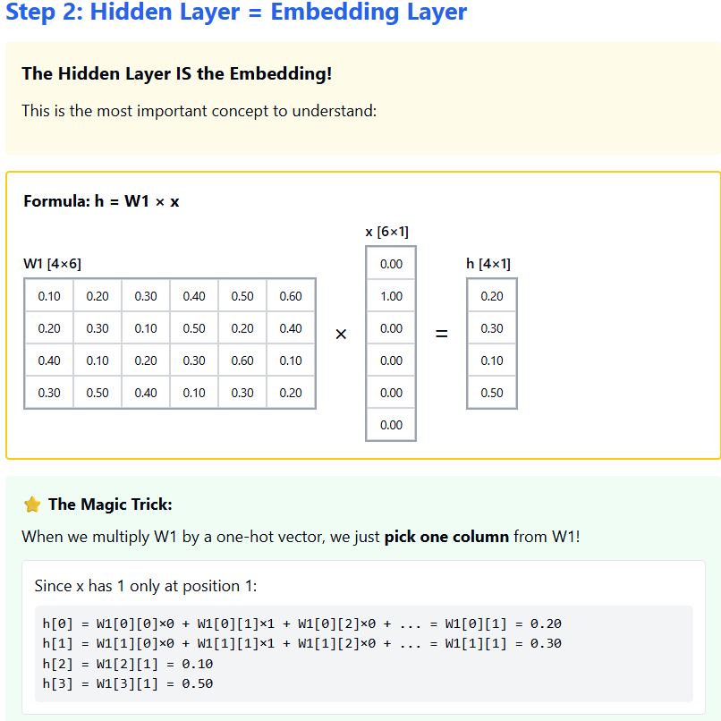
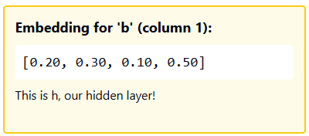

Slide 19
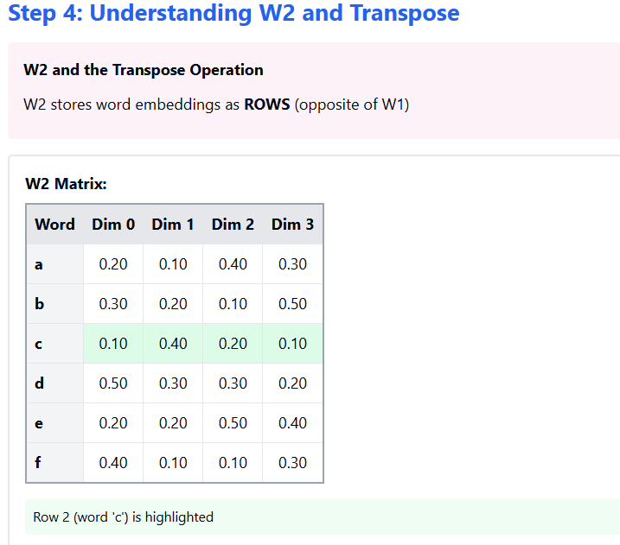

Slide 20
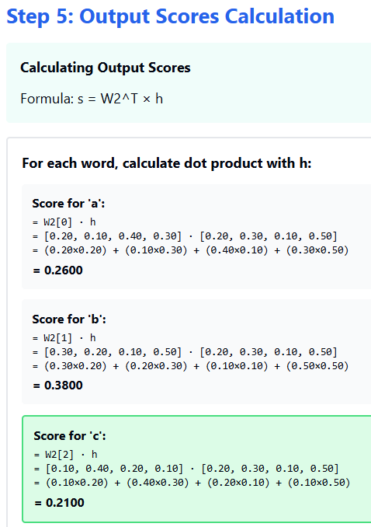
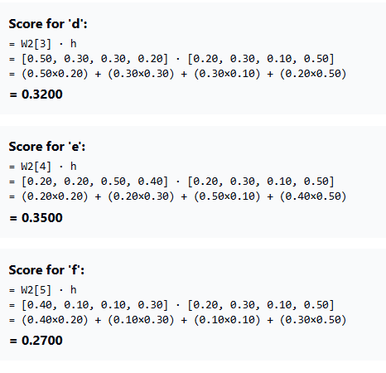

Slide 21
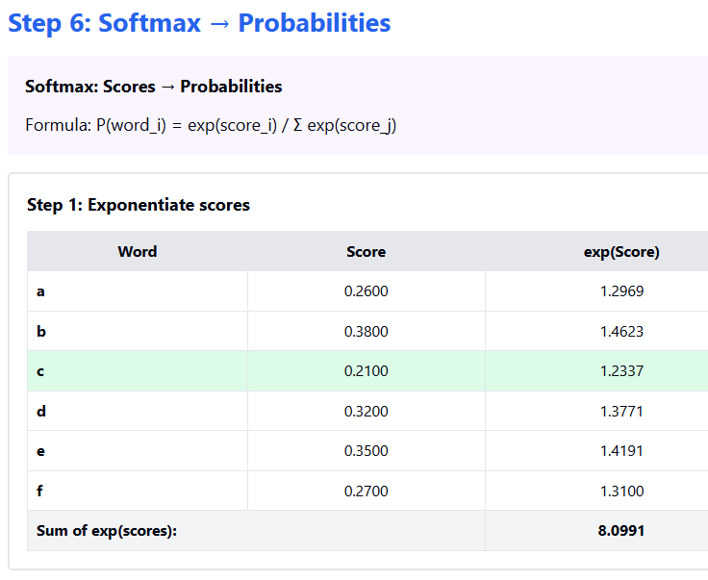
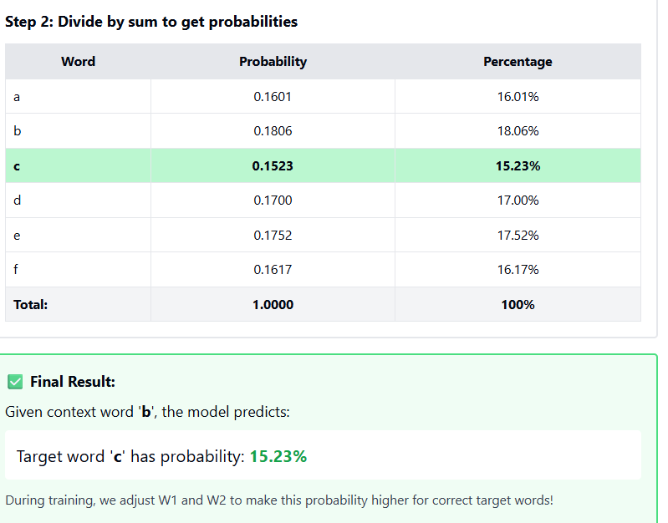

Slide 22
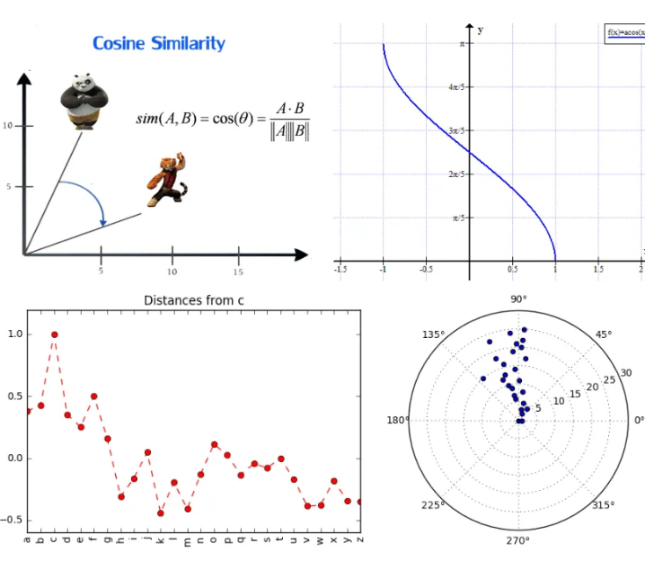
Cosine Similarity
Among different distance metrics, cosine similarity is more intuitive and most used in word2vec. It is normalized dot product of 2 vectors and this ratio defines the angle between them. Two vectors with the same orientation have a cosine similarity of 1, two vectors at 90° have a similarity of 0, and two vectors diametrically opposed have a similarity of -1, independent of their magnitude.
=aT.b (a Transpose multiply by b)

Slide 23
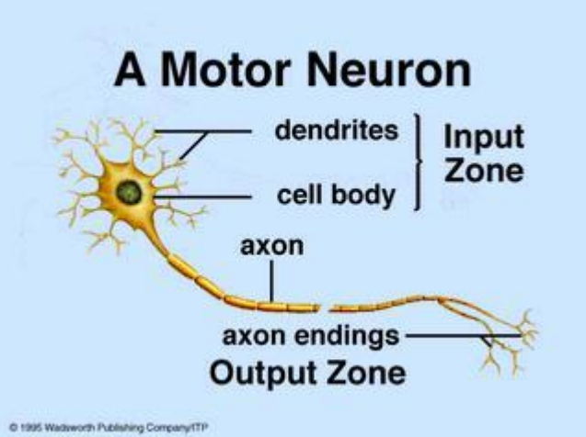
Biological Neural Networks
A biological neuron has three types of main components; dendrites, soma (or cell body) and axon.
Dendrites receives signals from other neurons.
The soma, sums the incoming signals. When sufficient input is received, the cell fires; that is it transmit a signal over its axon to other cells.

Slide 24
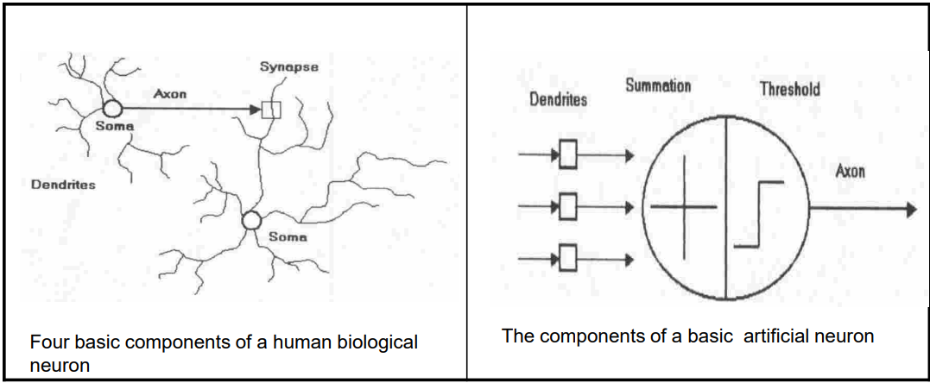
Artificial Neuron

Slide 25
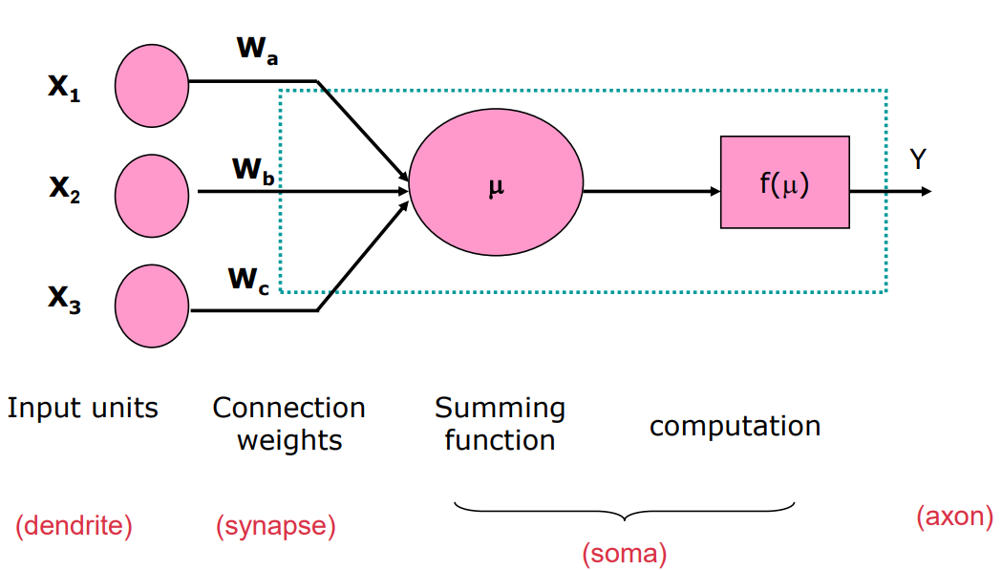
Model Of A Neuron

Slide 26
Neural Network Unit
Take weighted sum of inputs, plus a bias
Sigmoid

Slide 27
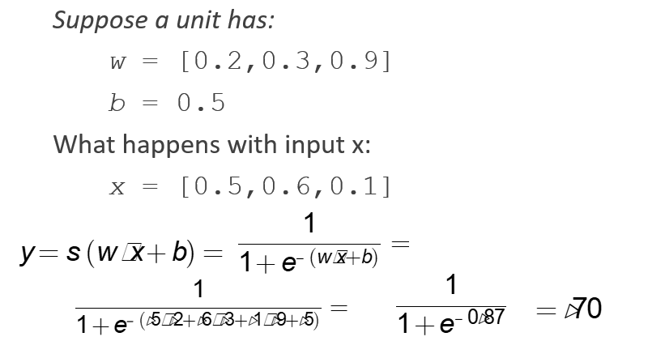
An example

Slide 28
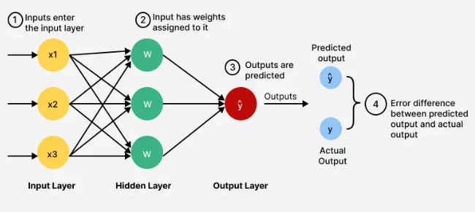
Feedforward Propagation
This is the process by which a neural network takes an input and processes it through its layers, applying weights and activation functions at each neuron, to produce a final output

Slide 29
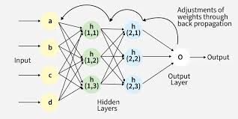
Backpropagation
This is an essential algorithm for training neural networks. After a feedforward pass is completed and the network’s error is calculated, backpropagation uses this error to compute the gradients of the loss function with respect to each weight and bias in the network. These gradients indicate how each parameter contributes to the error, allowing the network to adjust its weights and biases to reduce the error in future predictions.

Slide 30
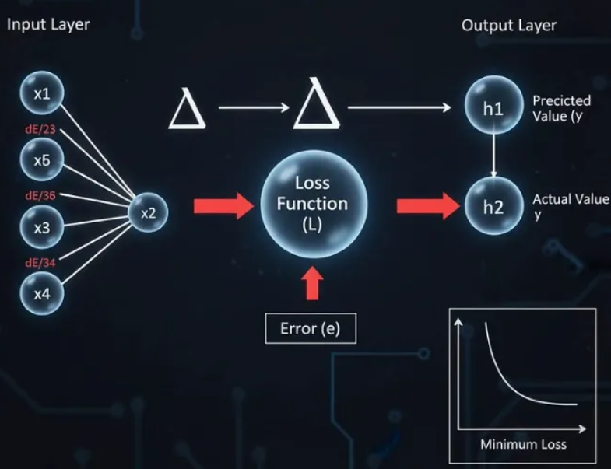
Loss Function
A loss function, also known as a cost or error function, is a metric that quantifies the difference between the network’s predicted output and the actual or desired output (the “target”). The goal of training a neural network is to minimize this loss function.

Slide 31
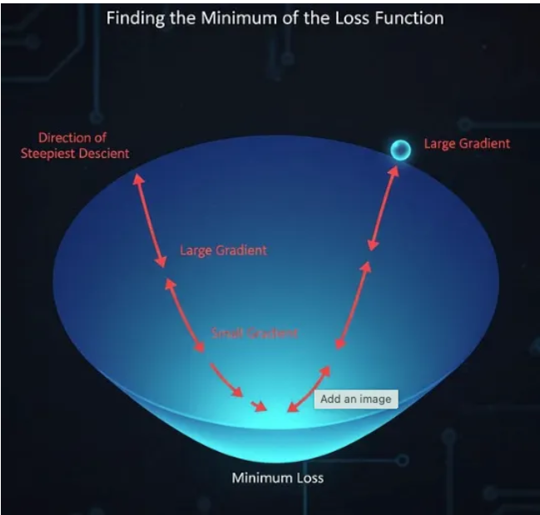
Gradient Descent:
This is an iterative optimization algorithm used to find the minimum of a function. In the context of neural networks, gradient descent is used to minimize the loss function. It does this by adjusting the network’s weights and biases in the opposite direction of the gradient (the steepest “slope”) of the loss function, which gradually reduces the network’s error.

Slide 32
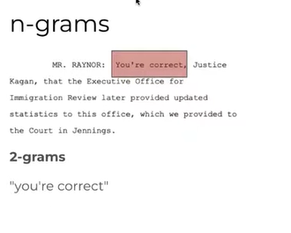
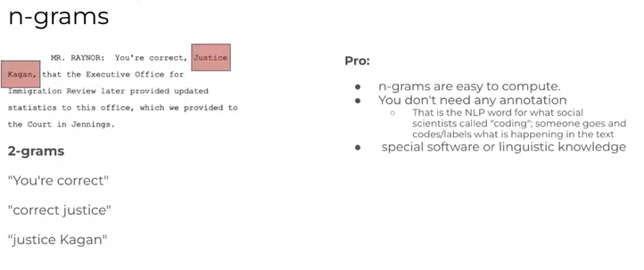
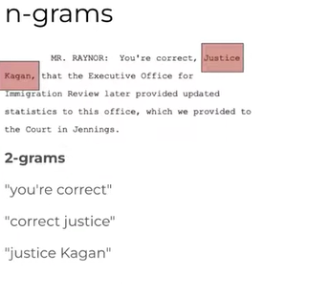

Slide 33
Thank You

